Slide 1

IBM Unsupervised Learning
Lucian Popa
February 21st 2022

Slide 2
Outline
Introduction;
Dataset description;
Methodology;
K-Means;
Conclusion.

Slide 3
Introduction
The heart is an amazing organ. It continuously pumps oxygen and nutrient-rich blood throughout your body to sustain life. This fist-sized powerhouse beats (expands and contracts) 100,000 times per day pumping 23,000 liters (5,000 gallons) of blood every day. To work properly, the heart (just like any other muscle) needs a good blood supply.
WHO announced that cardiovascular diseases is the top one killer over the world. There are seventeen million people died from it every year, especially heart disease. Prevention is better than cure. If we can evaluate the risk of every patient who probably has heart disease, that is, not only patients but also everyone can do something earlier to keep illness away.
A heart attack (also known as myocardial infarction; MI) is defined as the sudden blockage of blood flow to a portion of the heart. Some of the heart muscle begins to die during a heart attack, and without early medical treatment, the loss of the muscle could be permanent.
Conditions such as high blood pressure, high blood cholesterol, obesity, and diabetes can raise the risk of a heart attack. Behaviors such as an unhealthy diet, low levels of physical activity, smoking, and excessive alcohol consumption can contribute to the conditions that can cause heart attacks. Some factors, such as age and family history of heart disease, cannot be modified but are associated with a higher risk of a heart attack.
The goal:
The aim of this project is to apply unsupervised learning techniques to find whether an individual will develop a heart attack risk or not. More specifically, after some feature engineering and exploratory data analysis, the k-means and agglomerative clusteing algorithms will be explored.

Slide 4
Dataset description
For the exploration of the risk a person has to develop a heart attack, the Heart Attack Analysis & Prediction Dataset from *kaggle.com* was utilized.
There are thirteen features and one target as below:
age: The person's age in years
sex: The person's sex (1 = male, 0 = female)
cp: The chest pain experienced (Value 1: typical angina, Value 2: atypical angina, Value 3: non-anginal pain, Value 4: asymptomatic)
trestbps: The person's resting blood pressure (mm Hg on admission to the hospital)
chol: The person's cholesterol measurement in mg/dl
fbs: The person's fasting blood sugar (> 120 mg/dl, 1 = true; 0 = false)
restecg: Resting electrocardiographic measurement (0 = normal, 1 = having ST-T wave abnormality, 2 = showing probable or definite left ventricular hypertrophy by Estes' criteria)
thalach: The person's maximum heart rate achieved
exang: Exercise induced angina (1 = yes; 0 = no)
oldpeak: ST depression induced by exercise relative to rest
slope: the slope of the peak exercise ST segment (Value 1: upsloping, Value 2: flat, Value 3: downsloping)
ca: The number of major vessels (0-3)
thal: A blood disorder called thalassemia (3 = normal; 6 = fixed defect; 7 = reversable defect)
target: Heart disease (0 = no, 1 = yes)

Slide 5
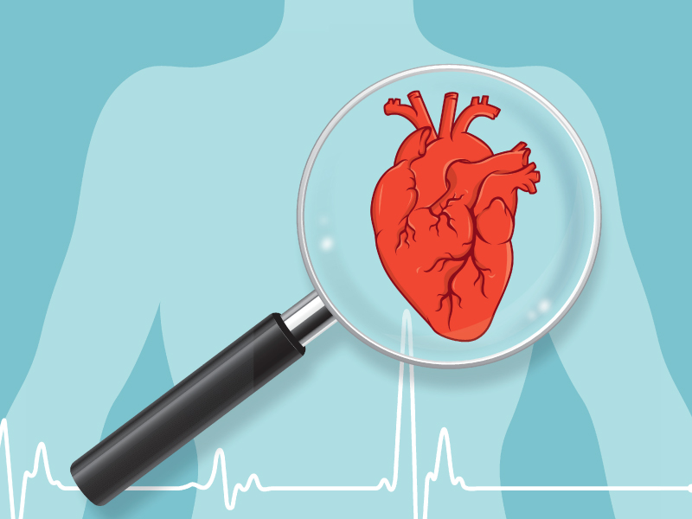
Methodology

Slide 6
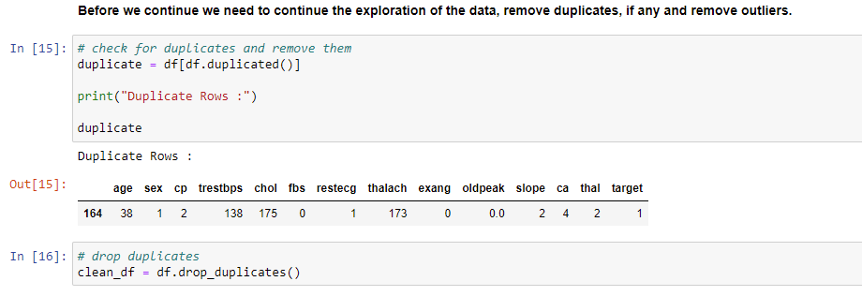
Data cleaning and preprocessing

Slide 7
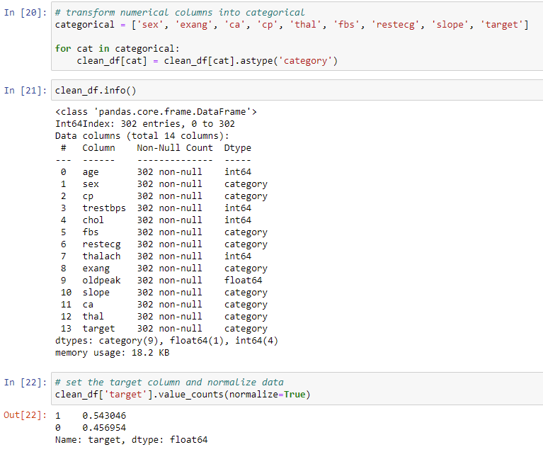
Data cleaning and preprocessing
Transform numerical columns into categorical features and normalize the target variable.

Slide 8
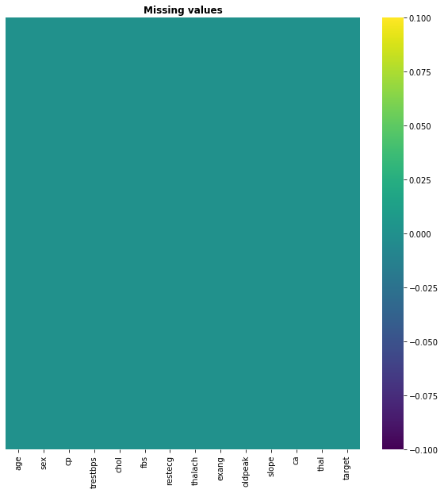
EDA and insights
Check for missing values

Slide 9
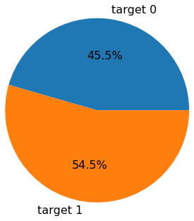
EDA and insights
Percentage of the people with heart disease
54.5 % of the people in this dataset were diagnosed with heart disease

Slide 10
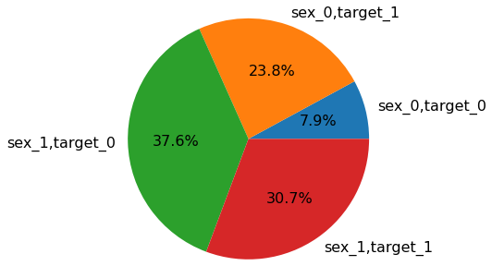
EDA and insights
Percentages of diagnosed by sex
The percentage of male diagnosed with heart disease is higher, 30.7% are male and 23.8% are female.

Slide 11
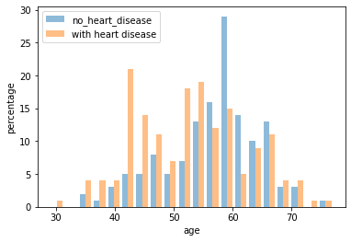
EDA and insights
Distribution by age of diagnosed people
According to this plot, people over 40 years old have a higher change of being diagnosed with heart disease.

Slide 12
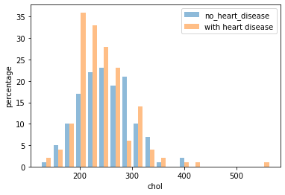
EDA and insights
Distribution of cholesterol
According to the research, the normal value of cholesterol should be lower than 200mg/dl. The number of people with heart disease spikes up when cholesterol goes above 200mg/dl.

Slide 13
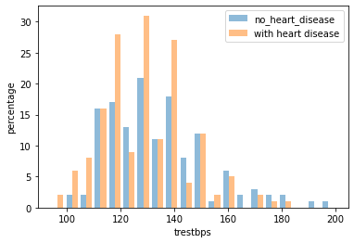
EDA and insights
Distribution of blood pressure while resting
The ideal blood pressure should be lower than 120 mmHg.

Slide 14
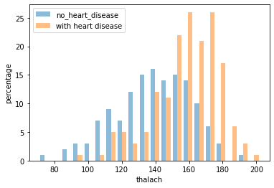
EDA and insights
Distribution of maximum heart rate ( which is negatively related to the age)
Seems like the heart rate is really high for those with heart disease.

Slide 15
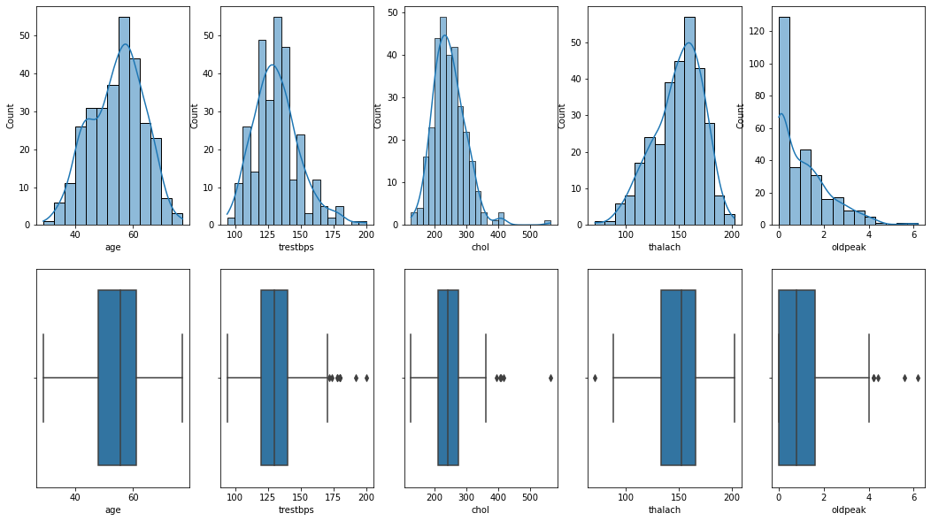
EDA and insights
Removing the outliers: Data with outliers

Slide 16
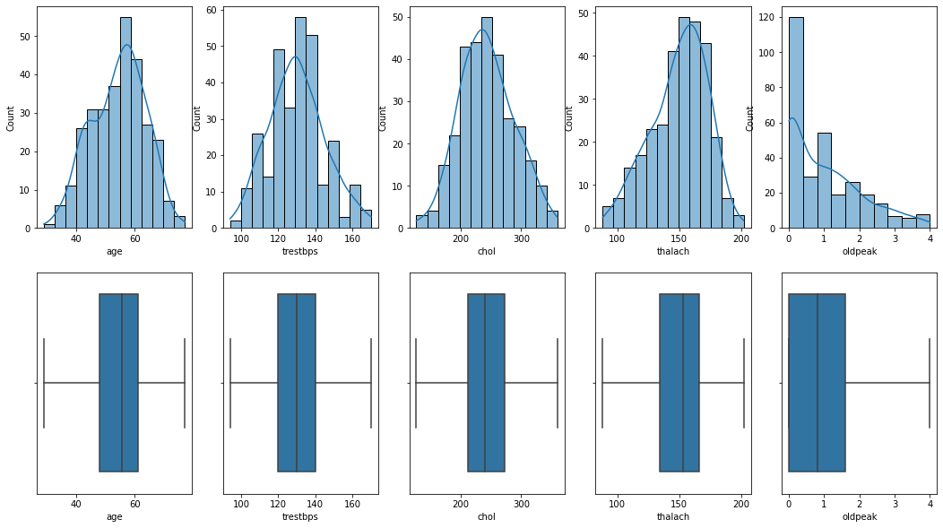
EDA and insights
Data without ouliers

Slide 17
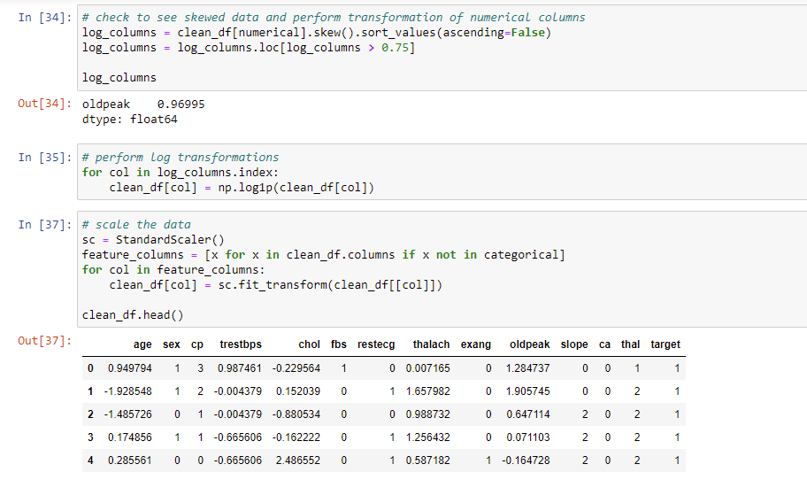
Log transformation and scaling the data

Slide 18
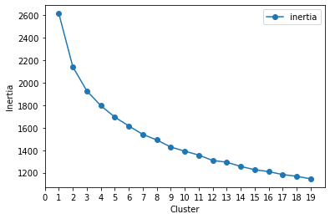
K-Means Clustering
diagram below shows a plot of inertia versus clusters
The plot of inertia versus number of clusters shows an elbow at number of clusters equal to 2, that is k =2.

Slide 19
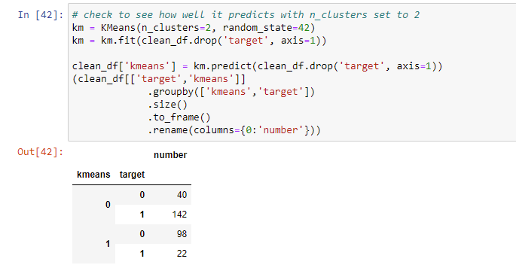
K-Means Clustering

Slide 20
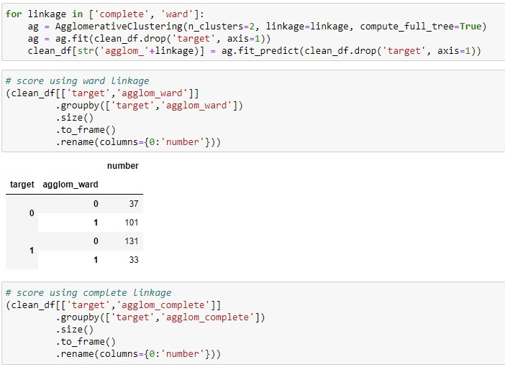
Agglomerative Clustering
Score using ward linkage

Slide 21
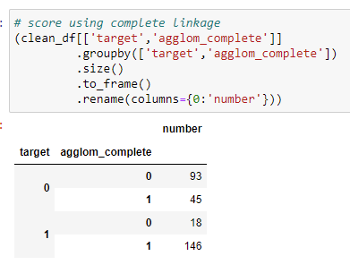
Agglomerative Clustering
Score Using complete linkage

Slide 22
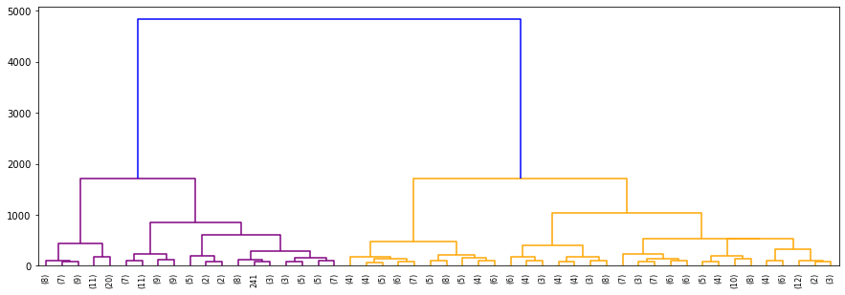
K-Means Clustering
Diagram below shows the dendrogram for the Hierarchical Agglomerative Clustering model

Slide 23
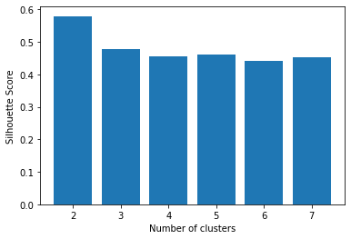
K-Means Clustering
Silhouette_scores by number of clusters

Slide 24
Conclusion
From the abovementioned analysis, a few important findings can be outlined. Performing both K-means and agglomerative clustering algorithms, one could observe that the best model for the prediction of a potential myocardial infarction is the **Complete-link agglomerative technique**. On the contrary, for predicting those cases that there won't be any implications, the most suitable is the **Ward-link agglomerative clustering**. From both the dendrogram and the silhoute score plots, it is evident that the optimal number of the clusters is **two**.

Slide 25
Next steps
As a further suggestion, a DBSCAN could be implemented, following a Principal Component Analysis.
Link to the Github Repo: https://github.com/LucianPopaLVP/Project-4---Unsupervised-Machine-Learning

Slide 26

Thank you!

